Slide 1

Seasonal Fashion Space Allocation
Notes:
Cody

Slide 2





Our Practicum Team
Cody Uhl
Team Lead
Computational Concentration
Stella Shipman
Team Scribe
Biomedical & Healthcare Concentration
Conrad Haslauer
Cybersecurity Concentration
Walmart Industry Partners
Christopher Rainey
Senior Manager - Advanced Analytics
Thomas Carter
Senior Manager - Assortment Analytics
Notes:
Everyone / Cody

Slide 3
1. The Problem
Notes:
Cody

Slide 4
Business Problem
Constraint: Retail stores have limited space
Decision: Walmart must determine how to allocate space to seasonal versus year-round product categories
Goal: Ensure customers can consistently find the products they expect
Notes:
Cody Retail space is limited, so Walmart has to make tradeoffs between seasonal and year-round products. The challenge is deciding how to allocate that space so customers can still find what they expect, while also maximizing efficiency. Q: Why not just increase space?
Physical store constraints make that unrealistic — we’re optimizing within fixed capacity.
Q: Why is this a hard problem?
Because demand varies by location, time, and category — so static rules don’t work well.

Slide 5
Project Question
What percentage of space should be allocated to seasonal categories in each store and fashion department?
Notes:
Cody
Our core question is: what percentage of space should be allocated to seasonal categories? This varies significantly depending on the store and demand patterns. Why focus on percentages instead of exact counts?
Percentages scale better across stores of different sizes and capacities.

Slide 6
Why it matters
Improved seasonal sales productivity
Increased customer satisfaction
﻿Optimal fixture utilization both in-season and out-of-season
Enhanced decision-making for space allocation
Notes:
Conrad

Slide 7
Literature Review
What We Found in the Literature
Key Takeaways for Our Problem
Most studies focus on SKU-level shelf-space optimization
Some research on seasonal planning, but limited to promotions and scheduling
Studies on classifying seasonal vs. non-seasonal demand using variation and clustering
A few address operational constraints or real-world implementation
SKU-level models are too granular for our context
Seasonal planning lacks fixture-level guidance
Data-driven classification can identify seasonal vs. year-round categories
There’s a gap in research on broader category-level strategies
Notes:
Conrad

Slide 8
2. The Data
Notes:
Stella
Notes:
- data source
- data access struggles
– got full datasets oct 27th (shift in data scope)
- limitations of Walmart laptops

Slide 9
Datasets
Weekly Merchandising Data – Men’s & Women’s Apparel
Additional Data Sources
Content:
Weekly sales across a subset of stores
Merchandising attributes (sales, inventory, category labels and fixture/space metrics)
Date Dimensions:
Date data related to Walmart Weeks
Useful for:
Identifying sales and demand trends
Measuring fixture allocation
Deriving model features
Store Dimensions:
Store attributes (e.g., location, region)
Notes:
Stella

Slide 10
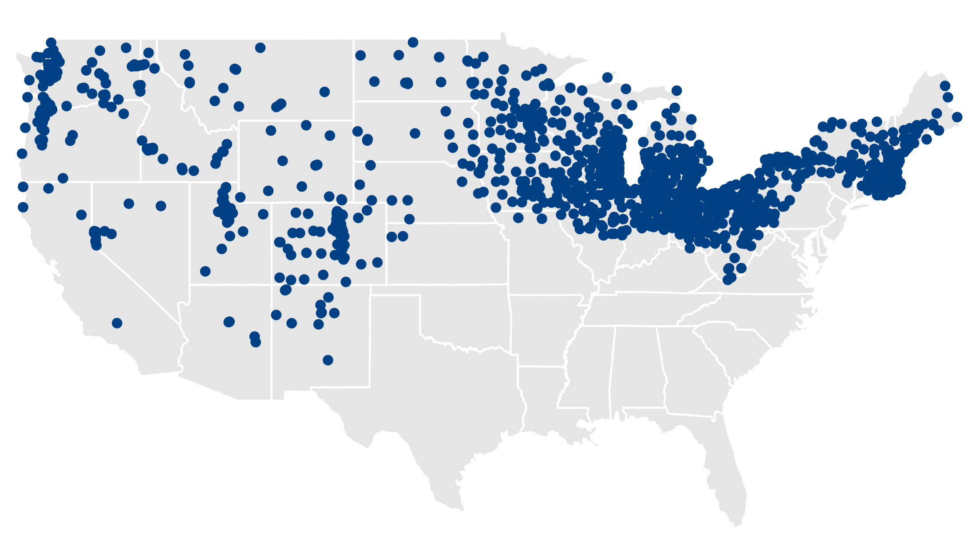
Data Overview
Scope:
Men’s: ~22 mil rows
Women’s: ~15 mil rows
Timeframe:
Weekly data from Sept 2023 – Sept 2025
Coverage:
~1,200 stores in 35 states (limited to cold weather cluster)
Store Map
Product Hierarchy
Department
Category Group
Category
Subcategory
Fineline
Notes:
Stella
Department -> women’s
Category Group -> activewear
Category -> reebok activewear
Subcategory -> reebok activewear jackets
Fineline -> reebok sprinter jacket

Slide 11
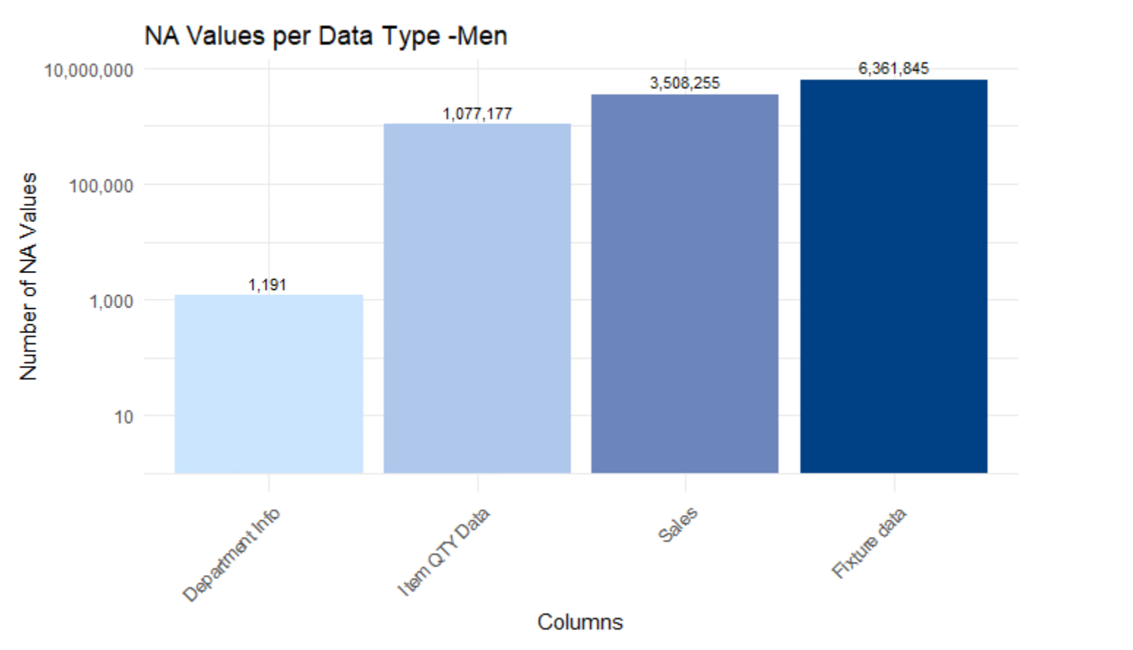
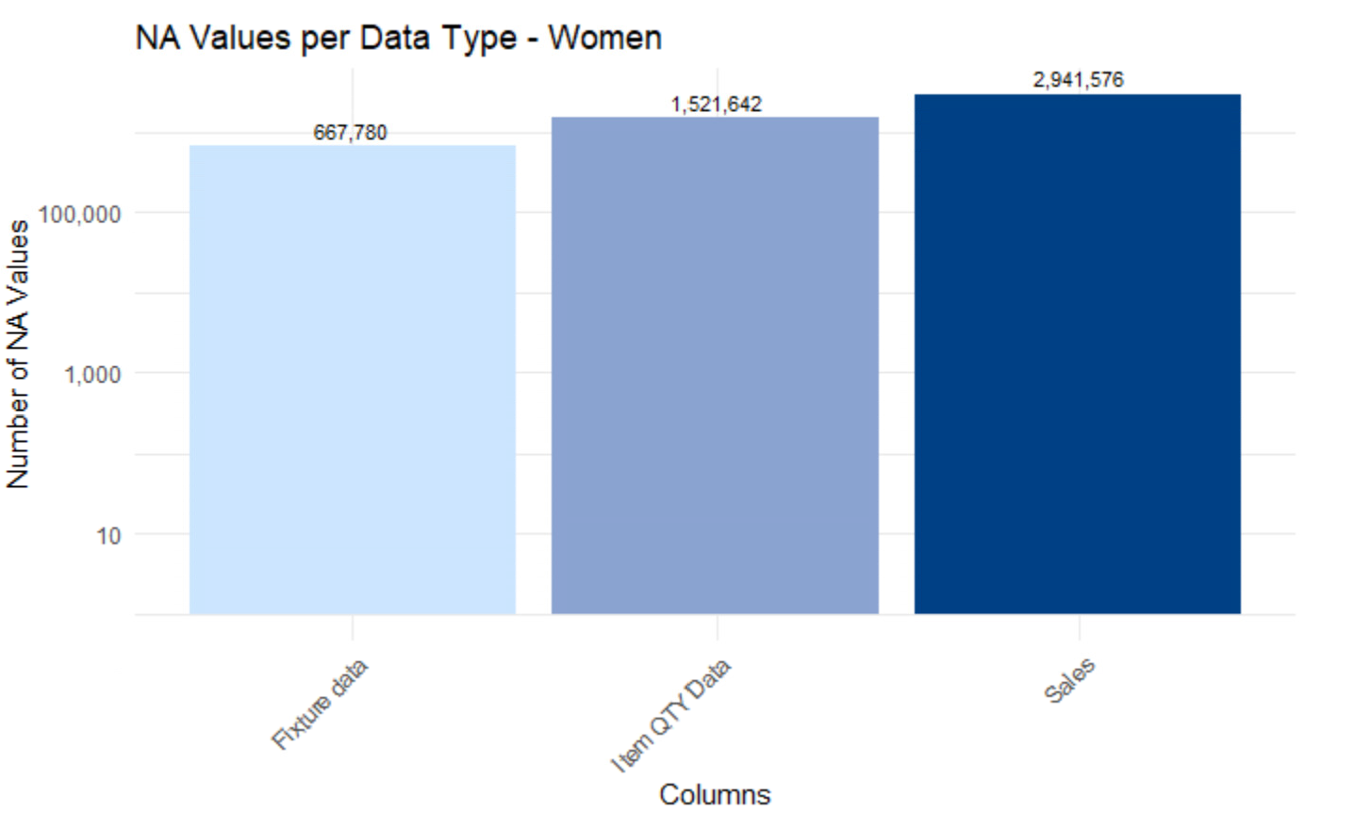
Data Cleaning
Missing Values:
Fixture data vs. mod plan comparison
Recovered ~2.3M rows
Unusual Values:
Negative values converted to 0
Impact on analysis is minimal
Redundant Columns:
QTY Data – At one point this was all nulls
 | Men's Negative | Women's Negative
Sales | ~ 216 K | ~ 517 K
Notes:
Conrad

Slide 12
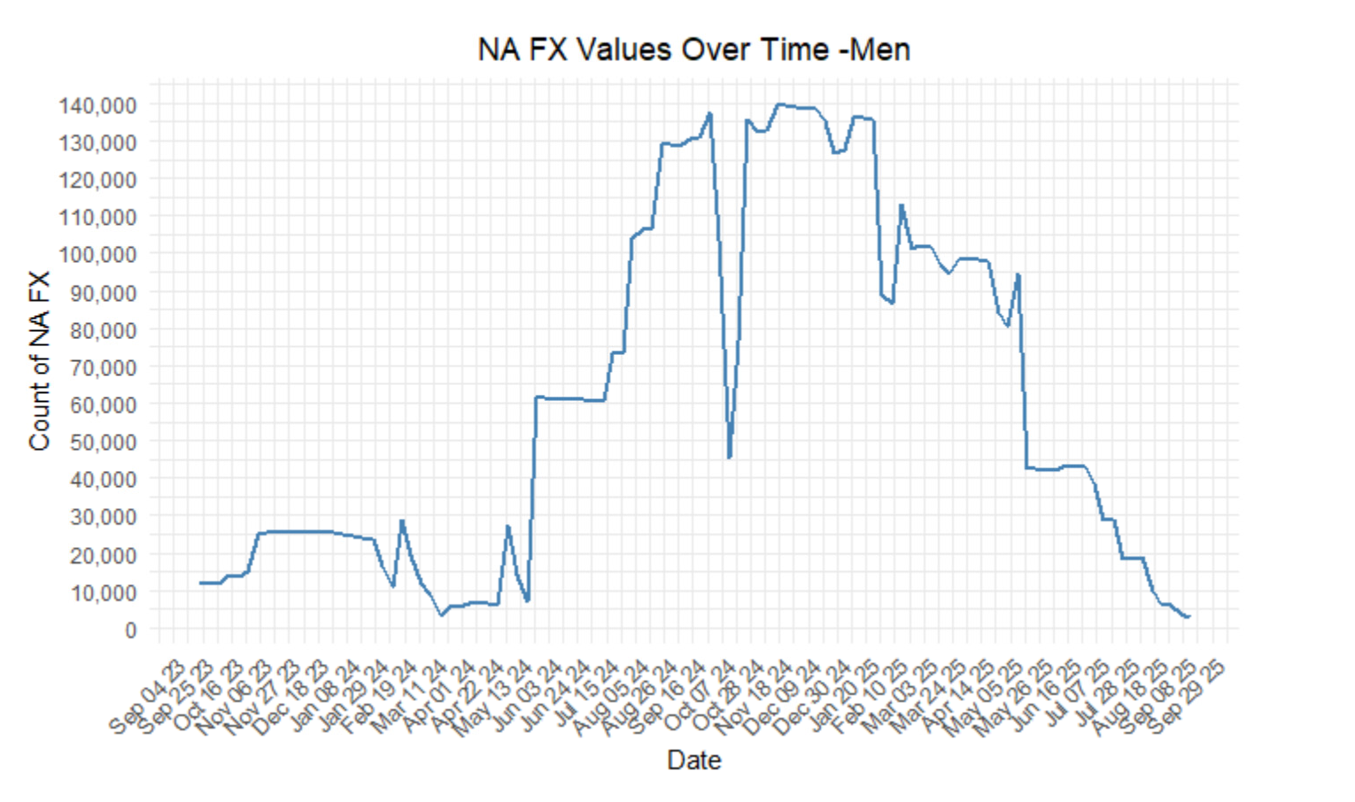
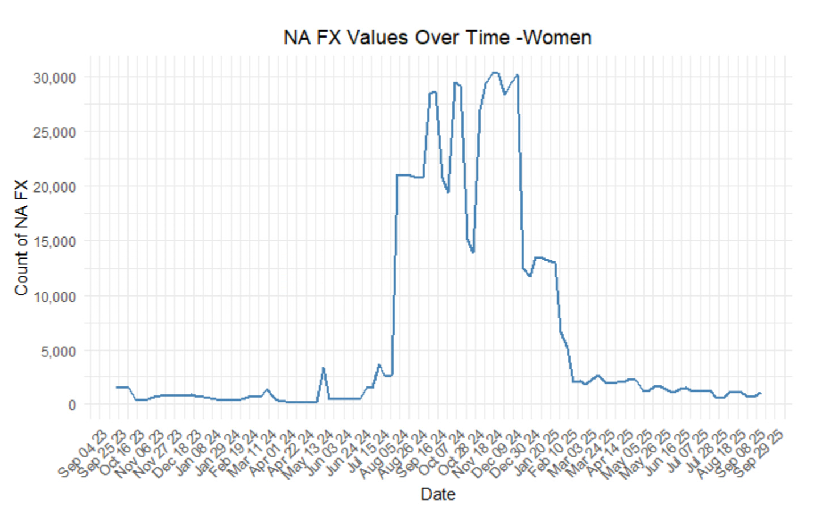
Null Issues
Generating Nulls:
Fixture data generated using mod plans
Increased usable data coverage
Not all nulls are equal:
Dropped mod plans with 100% missing fixture data
Dropped finelines with ≤ 3 sales
Department-level & QTY nulls retained
Summary:
Men’s records dropped: 4,490,173
Women’s records dropped: 240,278
Higher data quality issues observed in men’s data
Notes:
Conrad

Slide 13
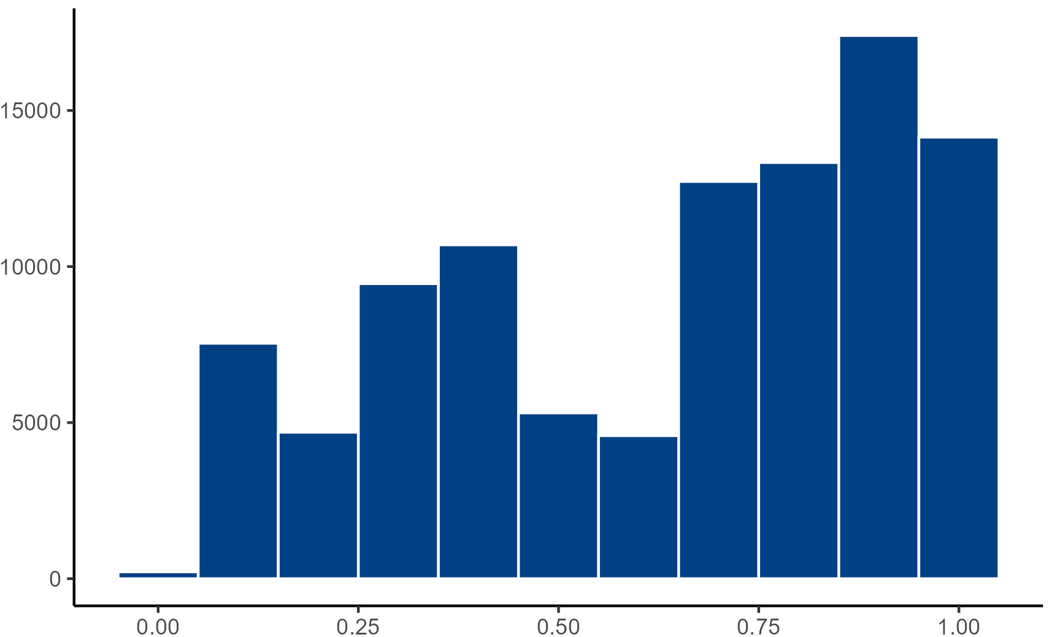
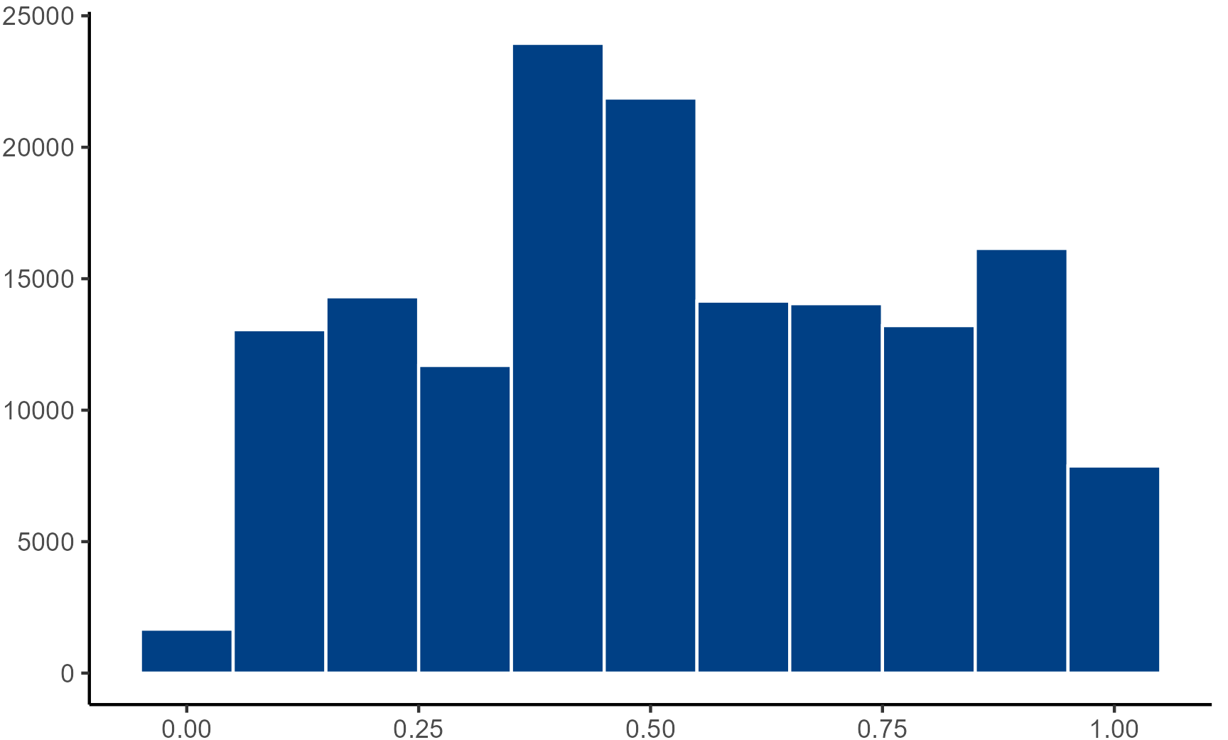
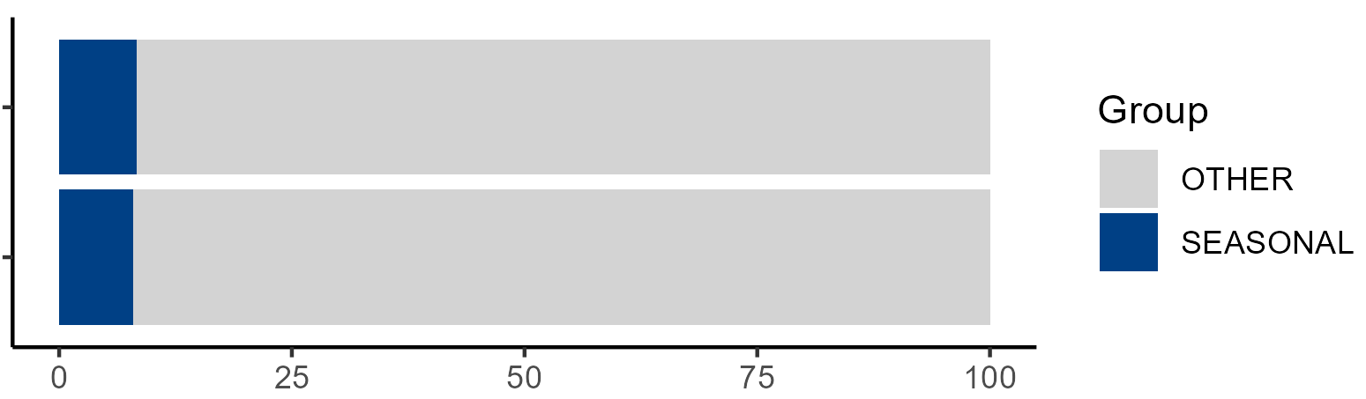
Exploring Seasonality
Distribution of Presence by Subcategory per Store
Takeaway: Subcategory presence varies widely across stores
Men’s
The existing “seasonal” grouping does not reflect true subcategory behavior
These insights motivated a data-driven classification to distinguish seasonal vs. year-round categories
Percent of Total Subcategories in ‘Seasonal’ Group vs Other
Women’s
Takeaway: Very few subcategories fall into the “seasonal” category group
Women’s
Count of Subcategories
Men’s
Percent
Proportion of Weeks Active (Active Weeks / Total Weeks)
Notes:
Stella
Why sub-category?
- category too general, ex would just be specific brand
- but sub-category gets specific enough to determine clothing type such as dresses or sweaters
- fineline a little to granular
Presence ratio:
- calculated per subcategory per store and then found avg per subcatg
- calculated using weeks present at that specific store divided by total weeks

Slide 14
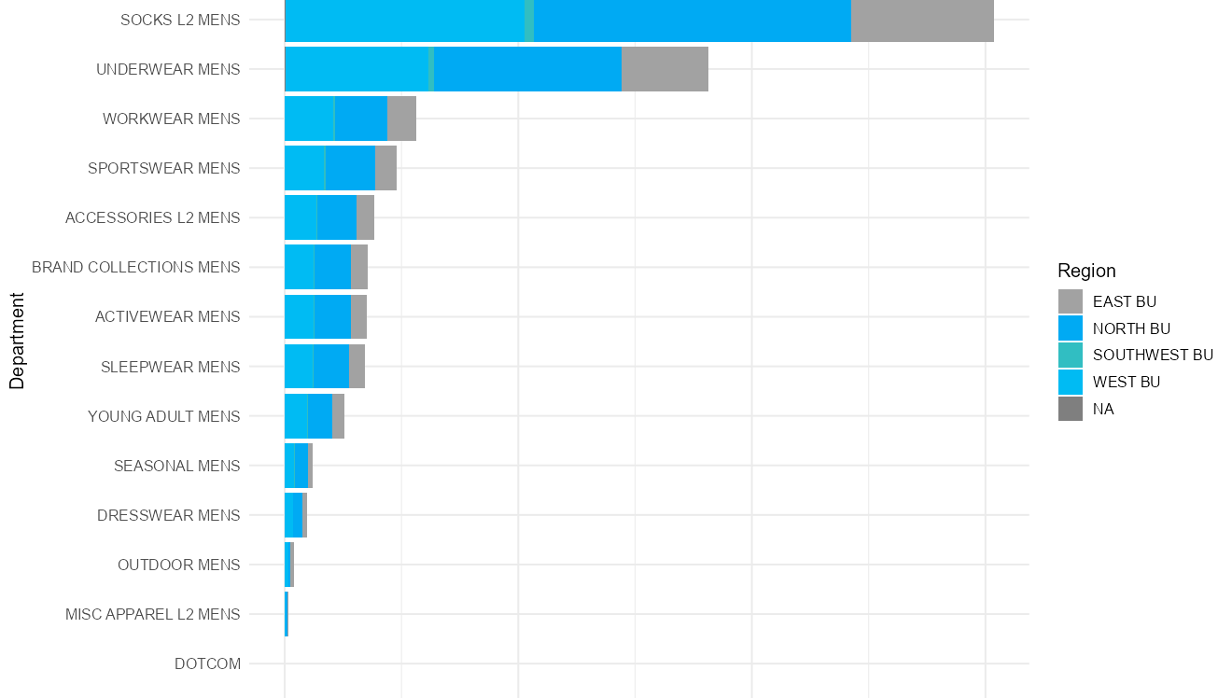
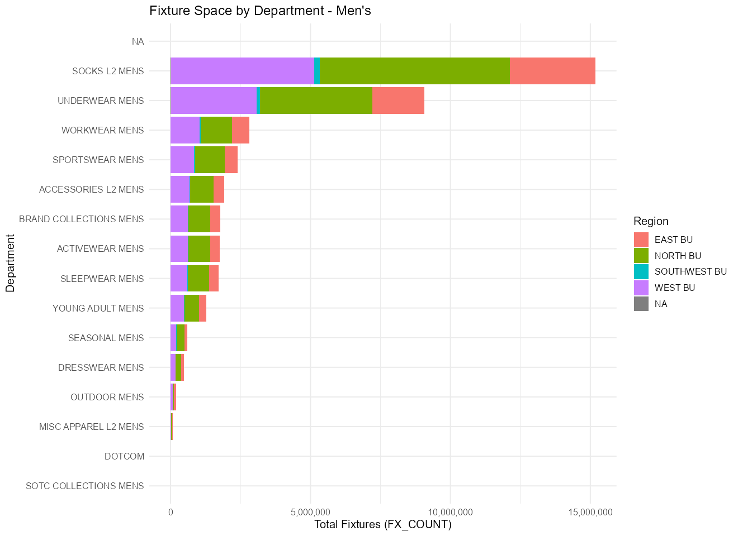
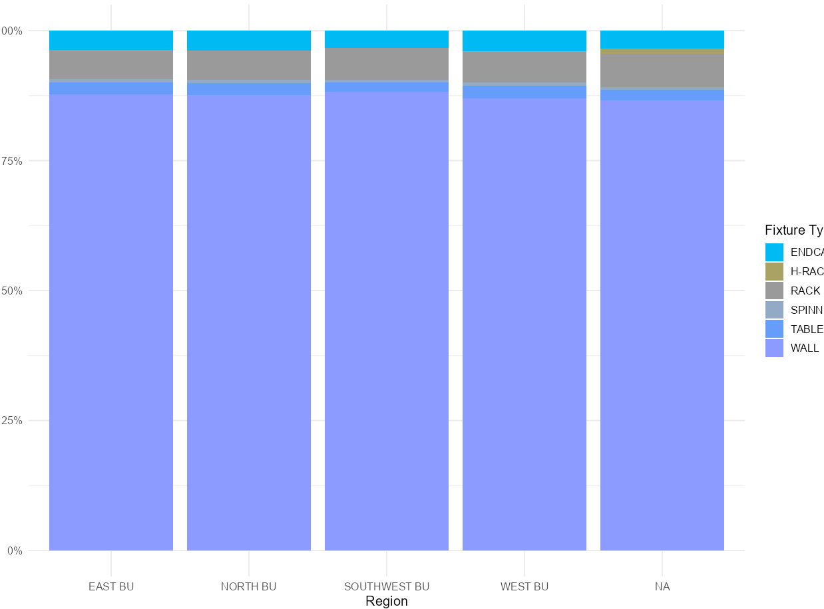
Men’s Departments: Stable and Uniform Space Allocation
Fixture Space by Category Group – Men’s
Category Group
Takeaway:
Fixture space is distributed across many subcategories
Allocation per subcategory is relatively small
Fixture usage is concentrated in wall-based fixtures
Total Fixtures
Fixture Type Mix by Region – Men’s
Share of Fixtures
Region
Notes:
Cody Men’s departments are very stable — space is spread across many subcategories, with smaller allocations per category. This creates consistency across stores. Why is men’s more stable?
Demand is less volatile — fewer seasonal swings compared to women’s.

Slide 15
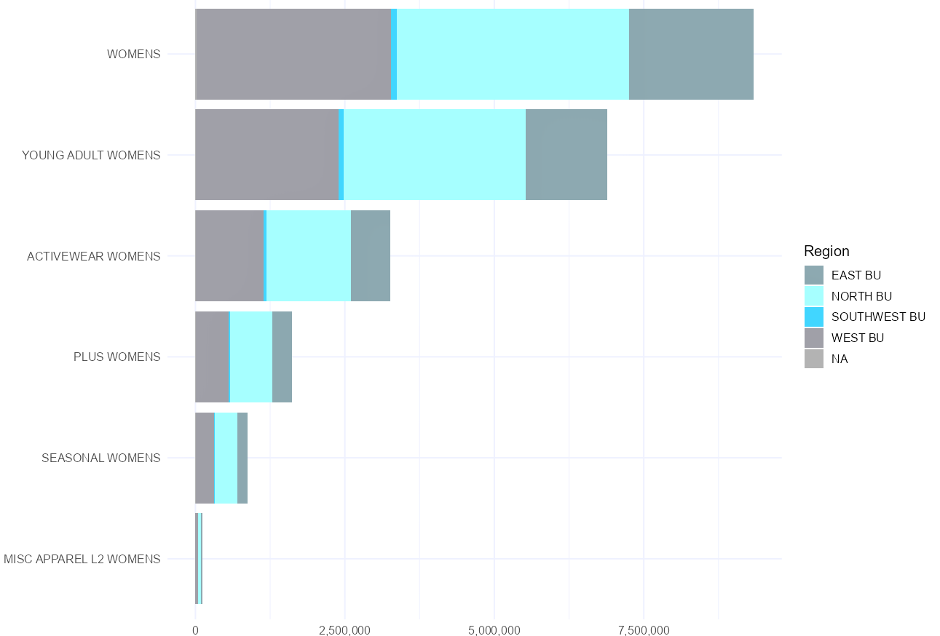
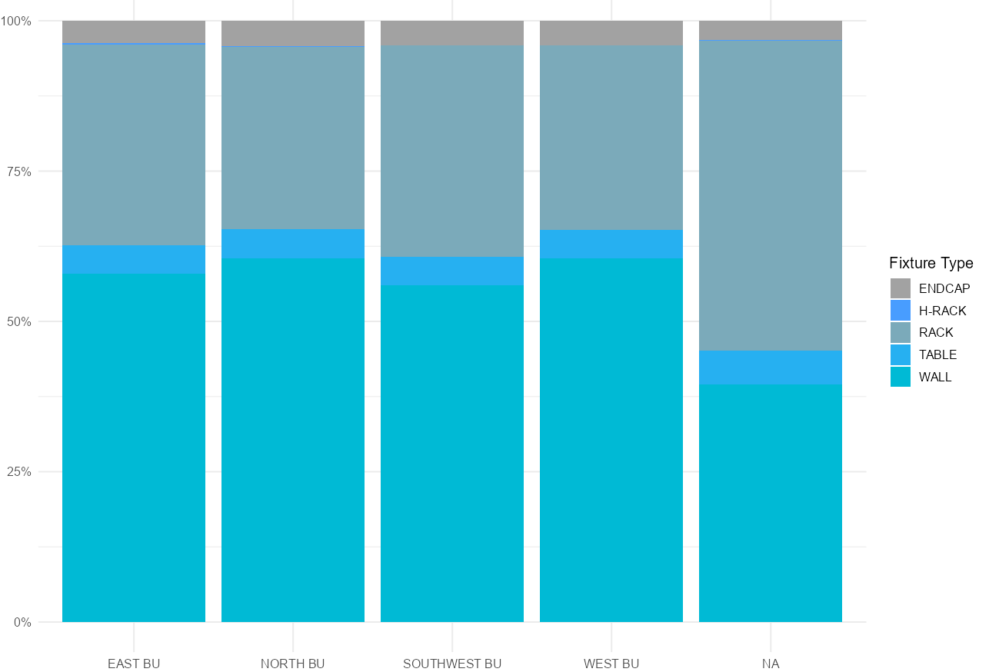
Women’s Departments: Flexible and Concentrated Space Allocation
Fixture Space by Category Group – Women’s
Category Group
Takeaway:
Fewer subcategories account for most fixture space
Larger allocations are given to key categories
Fixture usage is more diverse and adaptable
Total Fixtures
Fixture Type Mix by Region – Women’s
Share of Fixtures
Region
Notes:
Cody
Women’s departments are more concentrated and flexible — fewer subcategories take up most of the space, and allocations shift more based on trends.
Q: Why are women more flexible?
It’s more trend-driven and seasonal, so demand changes more frequently.

Slide 16
3. Modeling
Notes:
Conrad

Slide 17
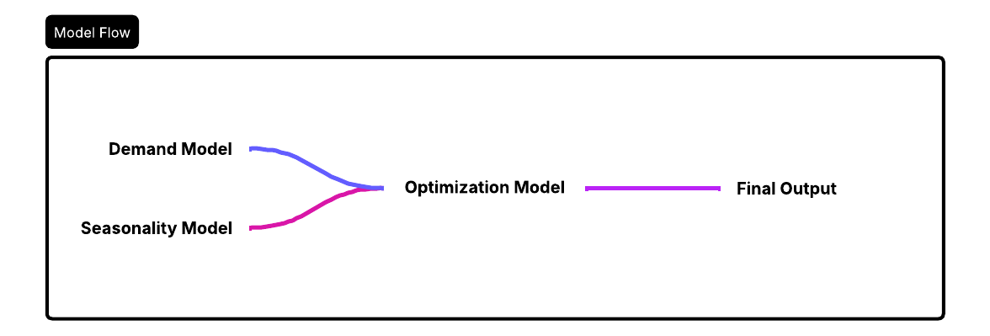
The Model – Development plan
Feature Engineering – Derive factors: Demand, seasonality.
Define goals – Set inventory percentage for year-round seasonal and clearance items.
Optimization Algorithm – find inventory splits to maximize revenue guided by the model.
Notes:
Conrad

Slide 18
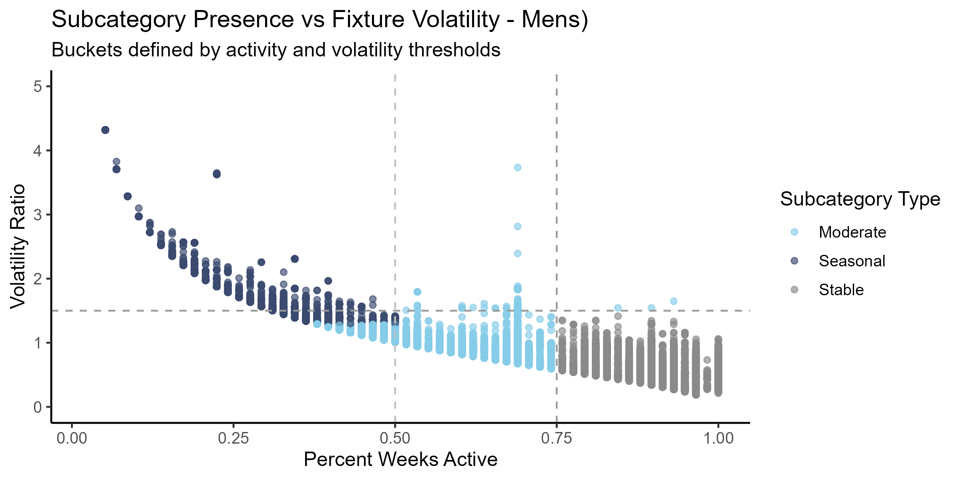
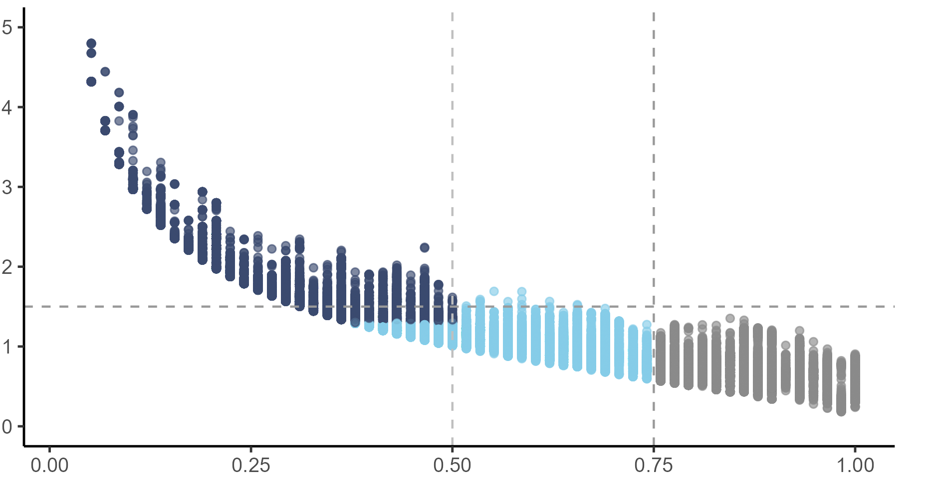
Subcategory Classification Framework
Subcategory Presence vs Fixture Volatility
Buckets defined by presence and volatility thresholds
Men’s
Fixture behavior is captured through presence and volatility at the subcategory level
Defines new, data-driven groups independent of existing category labels
Key metrics:
Presence: % of weeks active
Volatility: variation in fixture counts
Interpretable, rule-based classification:
Stable: High presence + low volatility
Seasonal: Low presence + high volatility
Moderate: Everything else
Women’s
Volatility Ratio
Proportion of Weeks Active
Notes:
Stella

Slide 19
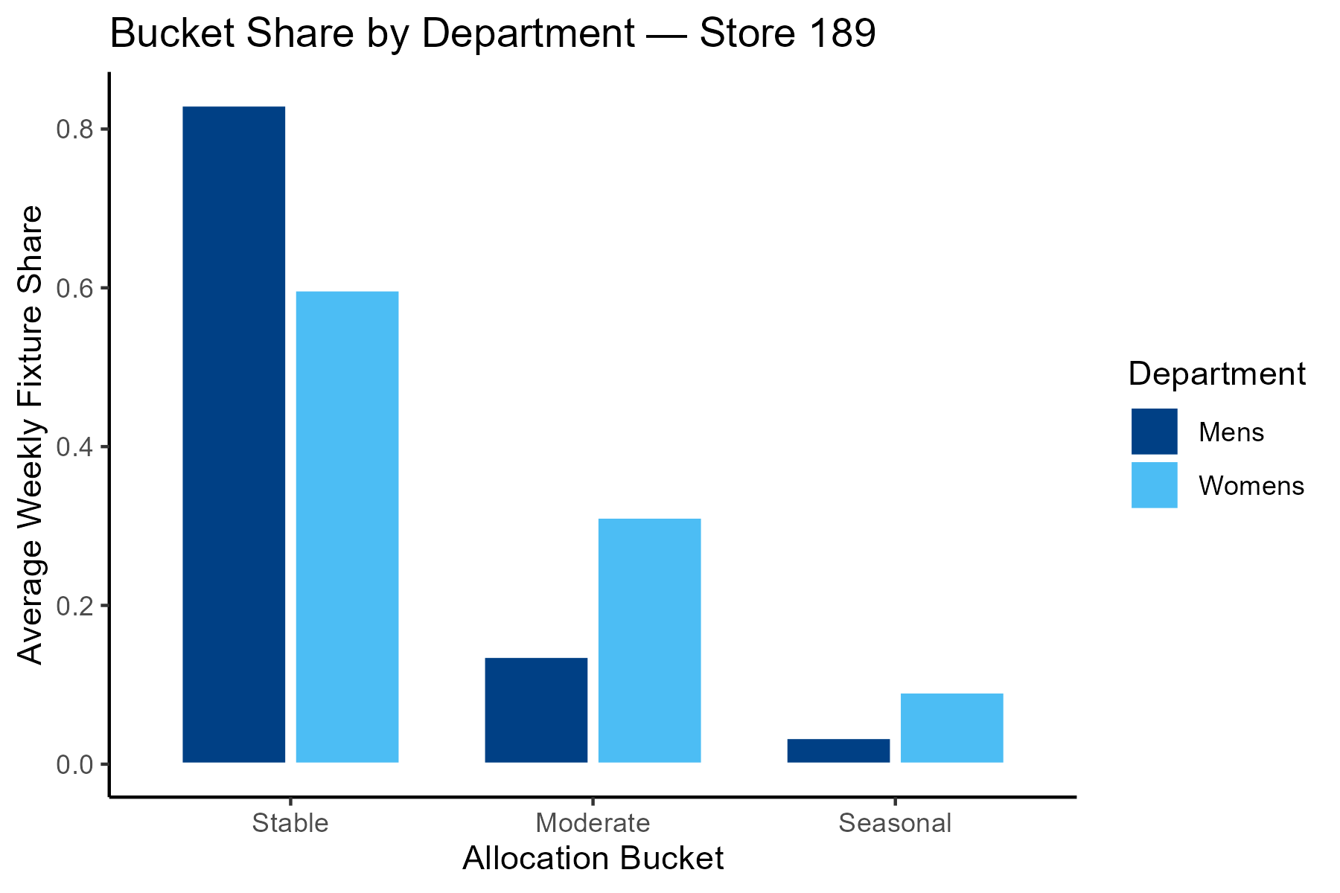
Subcategory Classification Output Tables
Store × Subcategory Table:
Metrics per combination
Includes classification, fixtures, presence, volatility
Store × Bucket Table:
Aggregated fixture allocation by bucket
Includes average space shares and fixture counts
Goal:
Provide information about fixture allocation trends using derived classification groups for use in the optimization model
Bucket Share by Department – Example Store
Average Weekly Fixture Share
Allocation Bucket
Notes:
Stella

Slide 20
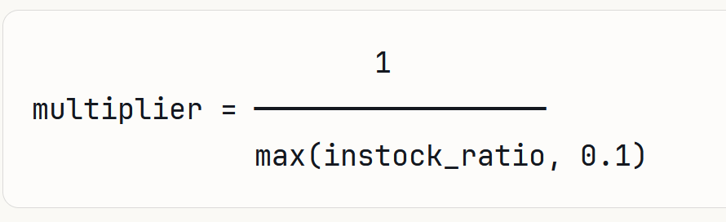
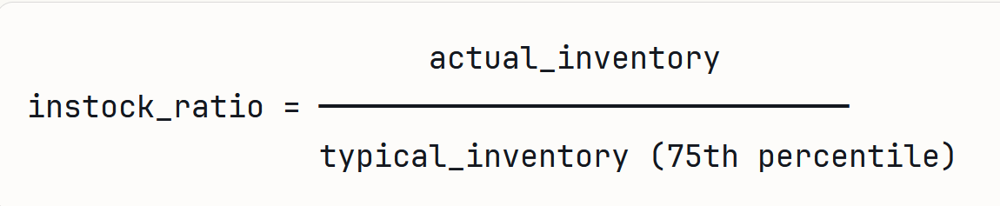
Demand Model
Objective:
Predict true customer demand at the subcategory level to optimize inventory allocation and prevent lost sales opportunities.
Business Impact:
Better inventory planning based on what customers want, not just what they bought
Reduced lost sales during high-demand periods
Improved stock allocation across 2.2M+ product-store combinations
Unconstrained demand score:
If a store has low inventory, sales will be artificially low. Not because customers don't want the product, but because it wasn't available.
Adjust sales upward when inventory was low.
Notes:
Conrad

Slide 21
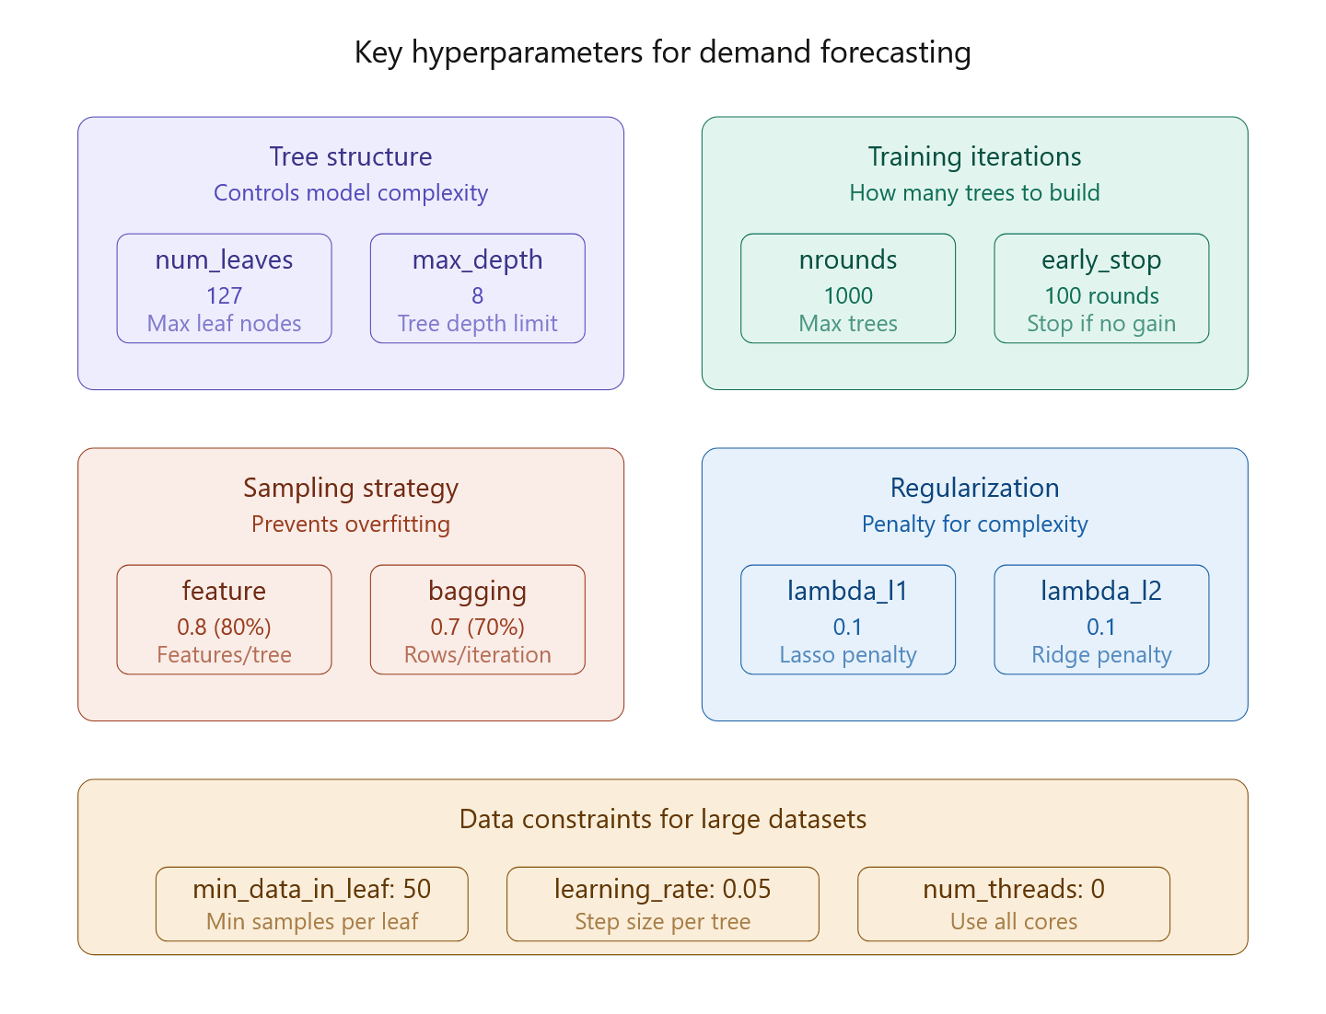
Demand Model
LightGBM:
Faster speed and higher accuracy: It outperforms other gradient boosting algorithms on large datasets.
Low memory usage: Optimized for memory efficiency and handling large datasets with minimal overhead.
Parallel and GPU learning support: Takes advantage of multiple cores or GPUs for faster training.
Effective on large datasets: Its optimized techniques such as leaf-wise growth and histogram-based learning make it suitable for big data applications.
Notes:
Conrad

Slide 22
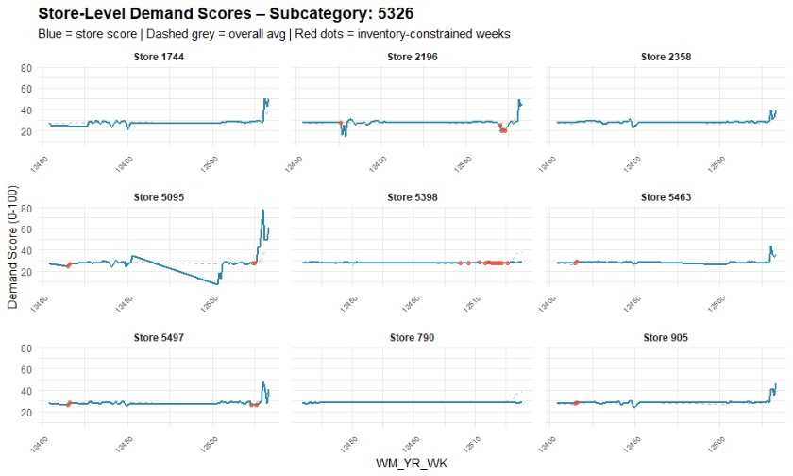
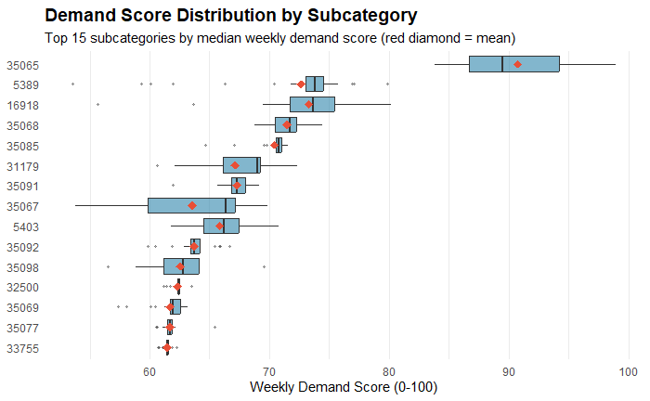
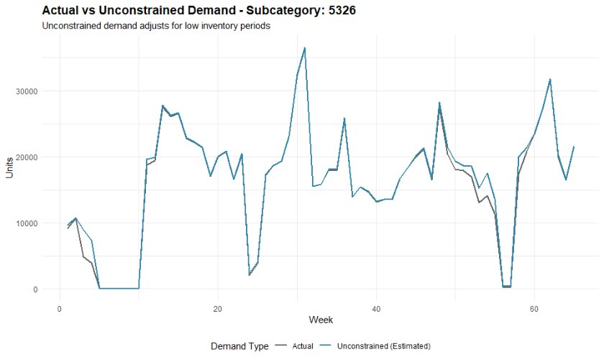
Demand Model - Outputs
Outputs are Subcategory x Store x Week
Notes:
Conrad

Slide 23
How We Translate Demand into Space Decisions
Each subcategory receives stable and flexible fixture allocations
Note: flex = moderate + seasonal space
Allocation decisions are driven by predicted demand scores
The model evaluates space at the store x week x subcategory level
We connect demand directly to how space is allocated
Notes:
Conrad
At a high level, we’re assigning space to each subcategory based on demand, while distinguishing between stable and flexible fixtures.

Slide 24

Optimization Model: Allocating Space to Maximize Value
Objective: $\text{Maximize} \text{total} \text{demand} \text{captured} \text{across} \text{all} \text{subcategories}$
$$max\sum{(Demand Score x Allocated Space)}$$
Decision Variables:
Stable fixture allocation
Flexible fixture allocation
Constraints:
Total stable and flexible space is limited
Each subcategory has a maximum allowable allocation
Allocations must be non-negative
Total fixture capacity must be respected at the store level
This model prioritizes high-demand categories within real-world constraints
Notes:
Cody
We maximize a demand-weighted objective, where predicted demand scores act as a proxy for revenue opportunity. So the model prioritizes allocating space to subcategories that are expected to drive the highest sales impact, while respecting real-world capacity and operational constraints.
Q: What exactly are you maximizing?
We’re maximizing a demand-based objective — essentially prioritizing space for subcategories with the highest predicted demand.
Q: What is ‘i’ in your model?
i represents a subcategory — decisions are made at the subcategory level.
Q: Why separate stable vs flexible?
Because they serve different purposes — stable ensures consistency, while flexible adapts to demand.
Q: Is this linear optimization?
Yes — it’s a linear optimization model with capacity and allocation constraints.
Q: Why not just allocate everything to the highest demand category?
We limit allocations per subcategory to prevent unrealistic over-concentration and reflect real store constraints.

Slide 25
4. Model Results
Notes:
Cody

Slide 26
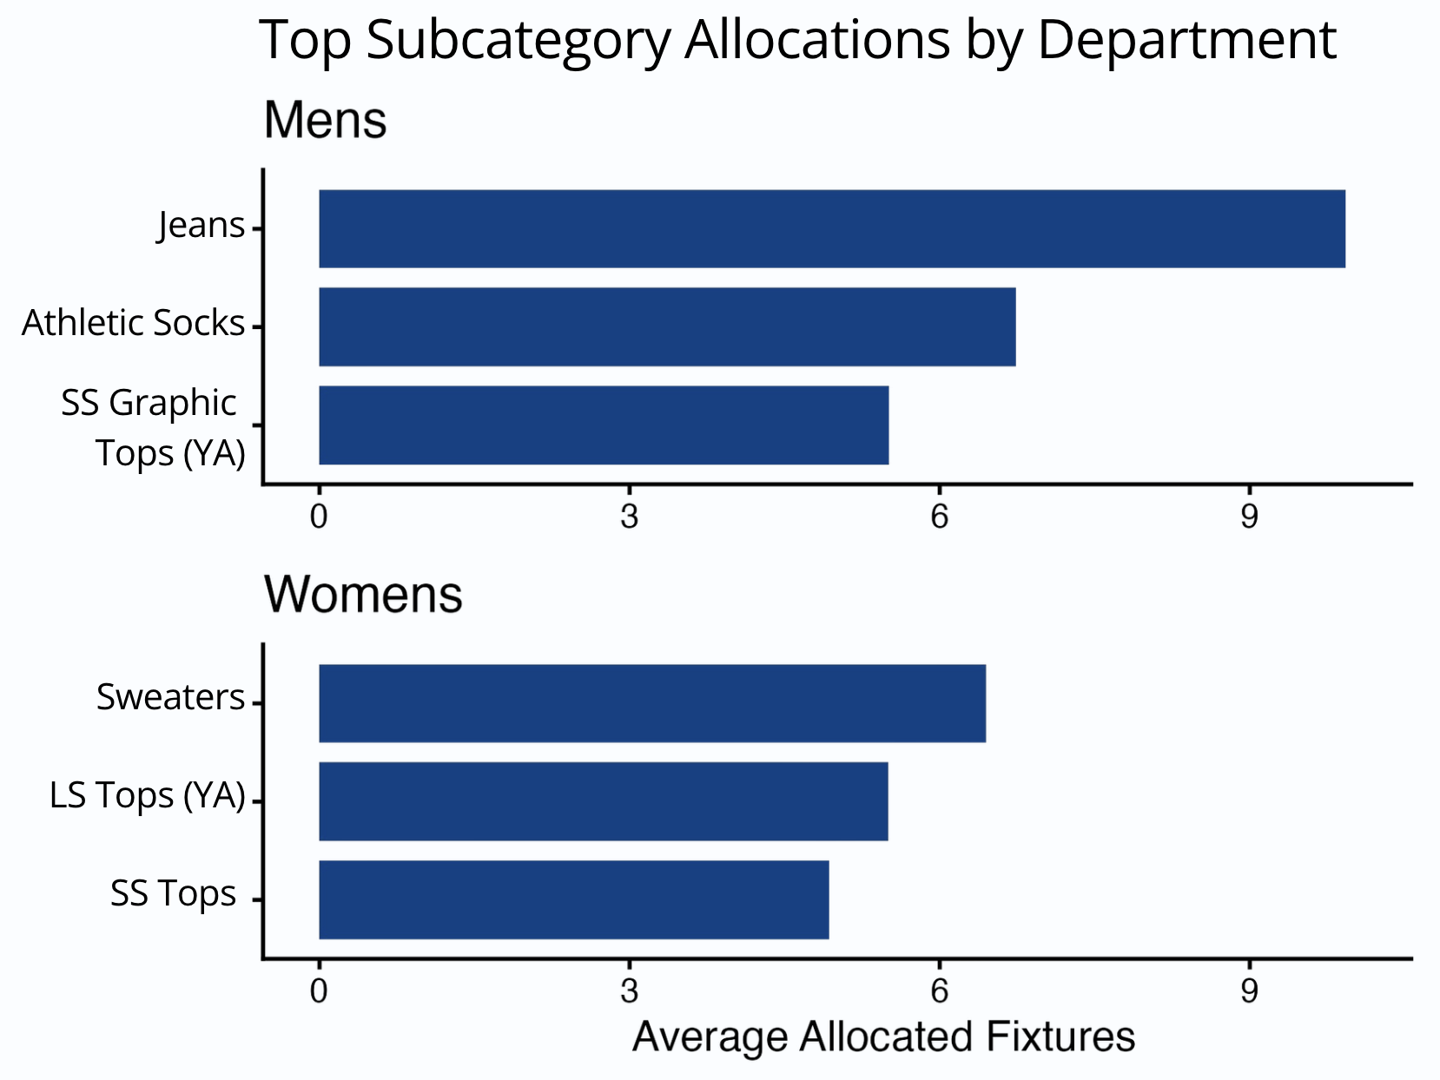
Where The Model Allocates Space For The Most Value
A small number of subcategories drive the majority of space allocation
High-demand categories consistently receive priority across stores
Space allocation is highly concentrated across a few key subcategories
Notes:
Cody
The model shows that space isn’t evenly distributed — a small number of high-demand subcategories receive most of the allocation.
Q: Is this realistic?
Yes — retail naturally follows a Pareto-like distribution where a few categories drive most performance.

Slide 27
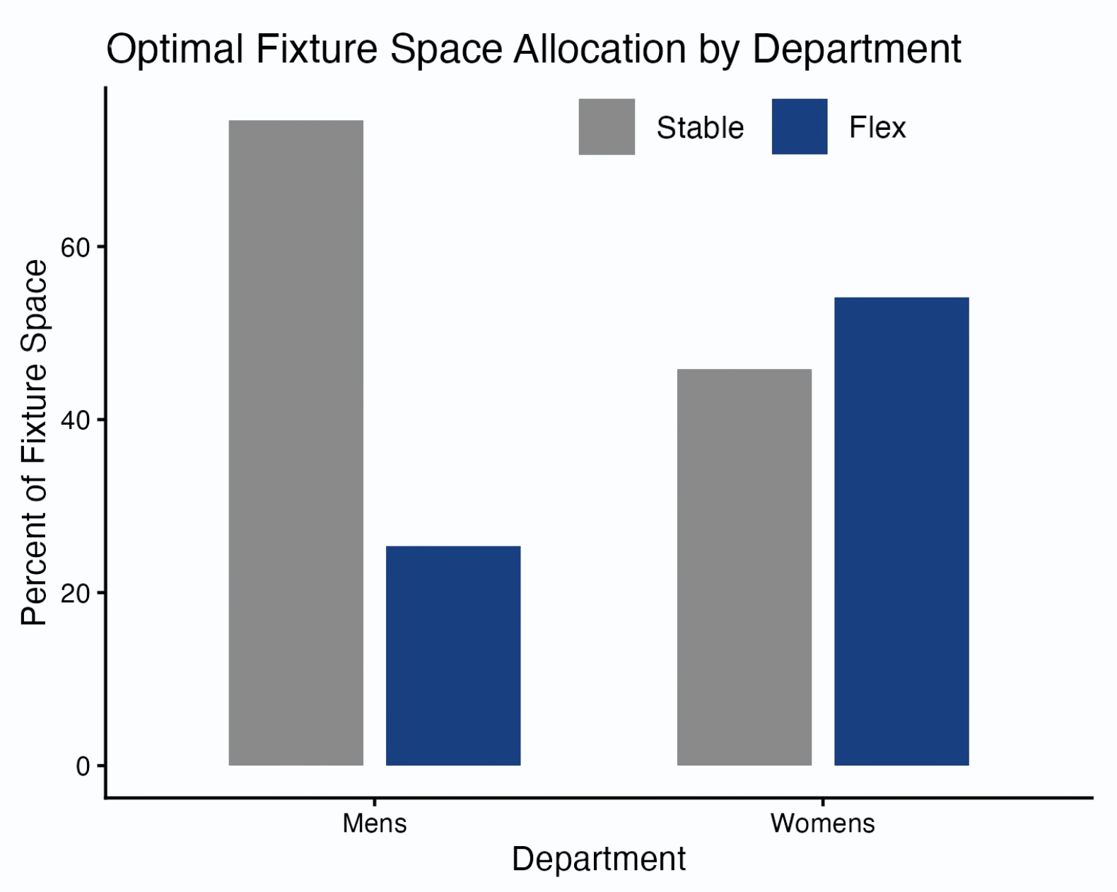
Balancing Stability and Flexibility
Men’s departments are dominated by stable fixture allocation
Women’s departments rely more heavily on flexible space
Different departments require different allocation strategies
Notes:
Cody
Men’s demand is more stable, so consistent allocation performs well. Women’s demand is more volatile and trend-driven, so flexible space allows the system to adapt and capture higher-value opportunities.
Q: Could Walmart standardize this across departments?
Our results suggest that would reduce efficiency — departments behave too differently.

Slide 28
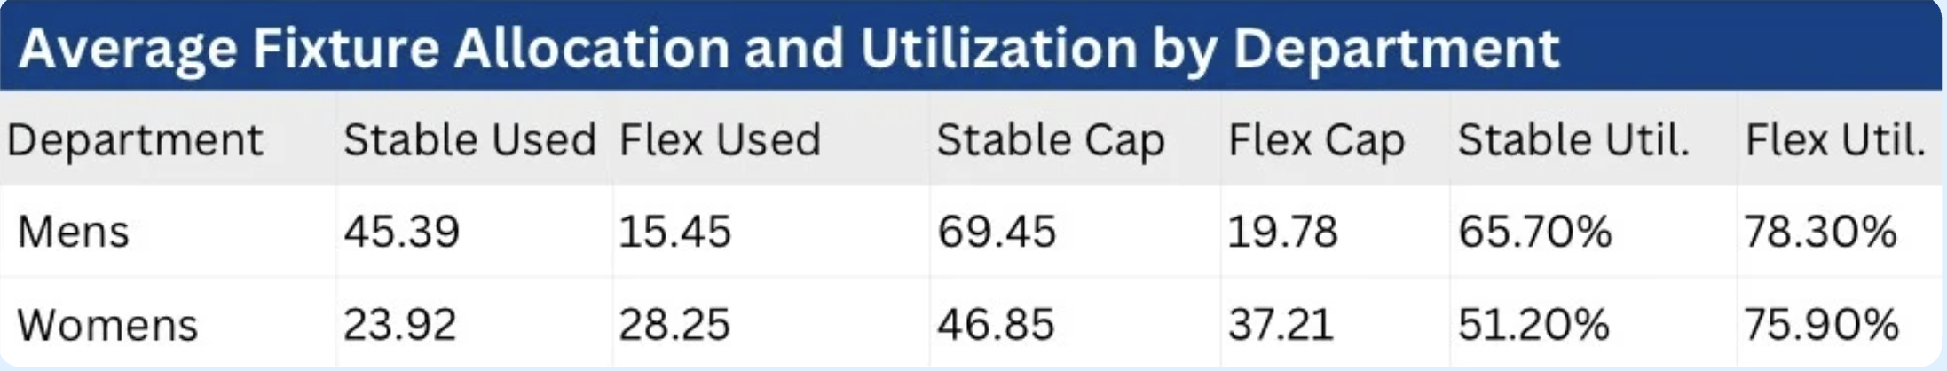
How Efficiently Space is Used by the Optimization Model
Flexible fixtures are consistently more fully utilized
Stable fixtures provide consistency but leave unused capacity
Reallocating space toward flexibility can improve efficiency
Notes:
Cody
Utilization is lower because the model is demand-constrained. Once high-value demand is satisfied, additional space would only go to lower-performing categories, which reduces overall efficiency. So the model intentionally leaves some capacity unused rather than over-allocating space with low return.
Q: Why is utilization low if you used optimization?
Because the model maximizes value, not usage. If there isn’t enough demand to justify using space, it leaves it unused rather than allocating inefficiently.
Q: Shouldn’t utilization be 100%?
Not necessarily — 100% utilization would likely mean over-allocating to low-demand categories.
Q: Where is unused space coming from?
Primarily stable fixtures, which are less responsive to demand.
Q: Is unused space bad?
Not always — it can reflect realistic constraints and prevent poor allocation decisions.

Slide 29
Key Insights Summary Based on model results
Fixture allocation is highly concentrated in a small number of subcategories
Departments exhibit distinct allocation balances between stable and flexible space
A small subset of stable categories consistently receives a large portion of allocated space
Men’s allocations skew more stable, while Women’s are more evenly balanced
Flexible space shows higher utilization relative to stable space
Stable space supports consistent product availability across stores
Reflects its role in adapting to changing demand
Providing a baseline allocation that complements flexible space
Notes:
Cody
Overall, allocation is concentrated in a few key subcategories. Flexible space improves efficiency, while stable space ensures consistency — both are necessary.
Q: What is the biggest takeaway?
That space should be allocated based on demand, not static rules.

Slide 30
Impact & Recommendations
Impact of the Approach
Model-Driven Recommendations
Replaces broad seasonal labels with store-specific allocation guidance
Quantifies stable vs. flexible fixture needs by subcategory
Improves fixture utilization using demand and seasonality patterns
Produces scalable outputs across stores and departments
Supports more consistent merchandising decisions
Prioritize space for high-demand subcategories
Increase flexible fixture capacity where feasible
Maintain stable space for core categories
Tailor allocation strategies by department
Notes:
Stella
The biggest value of this approach is that it moves fixture allocation from broad general rules toward store-specific, data-driven recommendations.
Rather than simply saying that high-demand categories should receive more space, the optimization model generates allocation outputs for every store, department, and subcategory based on both predicted demand and seasonality behavior.
This allows merchandising decisions to be much more precise—showing not just which categories matter most, but how stable versus flexible space should be distributed within each store.
For example, while we know core categories need consistent space, the model helps determine how much stable space is actually needed and where additional flexible capacity creates the most value.
We also found clear differences between men’s and women’s departments. Men’s departments were more heavily stable, while women’s relied more on flexible space, which suggests allocation strategies should be tailored by department rather than applying a single standard across all fashion areas.
Overall, the model provides a scalable framework for making more consistent and measurable space planning decisions across a large store network.

Slide 31
Next Steps & Key Takeaways
Next Steps for Model Improvements
Project Takeaways
Further validate and refine demand scoring
Expand model to include store clustering (region/weather)
Improve fixture-type constraints for more realistic allocation
Expand to other departments
Validate recommendations with pilot store testing
Accurate analysis required extensive preprocessing and validation
Retail data complexity required iterative refinement
Large-scale data required structured approaches for meaningful analysis
Business context was essential for guiding modeling decisions
Notes:
Stella
Looking ahead, there are several ways this model could be improved and expanded.
First, demand scoring can be further validated and refined to better capture true customer demand, since the optimization depends heavily on how accurately we estimate unconstrained demand.
Store clustering could also be expanded using factors like region, weather, and local demand patterns, since stores in different markets may require very different seasonal strategies.
Improving fixture-type constraints would make the optimization outputs even more realistic by better reflecting operational limitations within stores.
We would also want to expand this framework beyond men’s and women’s apparel to see how well it generalizes across other departments.
Ultimately, pilot testing these recommendations in stores would be the best way to measure real business impact and validate whether the model improves both fixture utilization and sales performance.
… talk about takeaways

Slide 32
References
Ishichi, K., Ohmori, S., & Ueda, M., & Yoshimoto, K. (2019). Shelf-space Allocation Model with Demand Learning. Operations and Supply Chain Management: An International Journal, 12(1), 24-40. http://doi.org/10.31387/oscm0360219
Andrew Lim, Brian Rodrigues, Xingwen Zhang, (2004) Metaheuristics with Local Search Techniques for Retail Shelf-Space Optimization. Management Science 50(1):117-131. https://doi.org/10.1287/mnsc.1030.0165
Smith, S. A., Agrawal, N., & McIntyre, S. H. (1998). A discrete optimization model for seasonal merchandise planning. Journal of Retailing, 74(2), 193–221. https://doi.org/10.1016/s0022-4359(99)80093-1
Düsterhöft, T., Hübner, A. (2023). Problems and Opportunities of Applied Optimization Models in Retail Space Planning. In: Ghoniem, A., Maddah, B. (eds) Retail Space Analytics. International Series in Operations Research & Management Science, vol 339. Springer, Cham. https://doi.org/10.1007/978-3-031-27058-1_8
Gonca P. Soysal, Lakshman Krishnamurthi, (2012) Demand Dynamics in the Seasonal Goods Industry: An Empirical Analysis. Marketing Science 31(2):293-316. https://doi.org/10.1287/mksc.1110.0693
Kandemir, B. (2022). A Methodology for Clustering Items with Seasonal and Non-seasonal Demand Patterns for Inventory Management. Journal of Advanced Research in Natural and Applied Sciences, 8(4), 753-761. https://doi.org/10.28979/jarnas.1112146
Notes:
Stella

Slide 33
Thank You
Notes:
Stella

Slide 34
Appendix

Slide 35
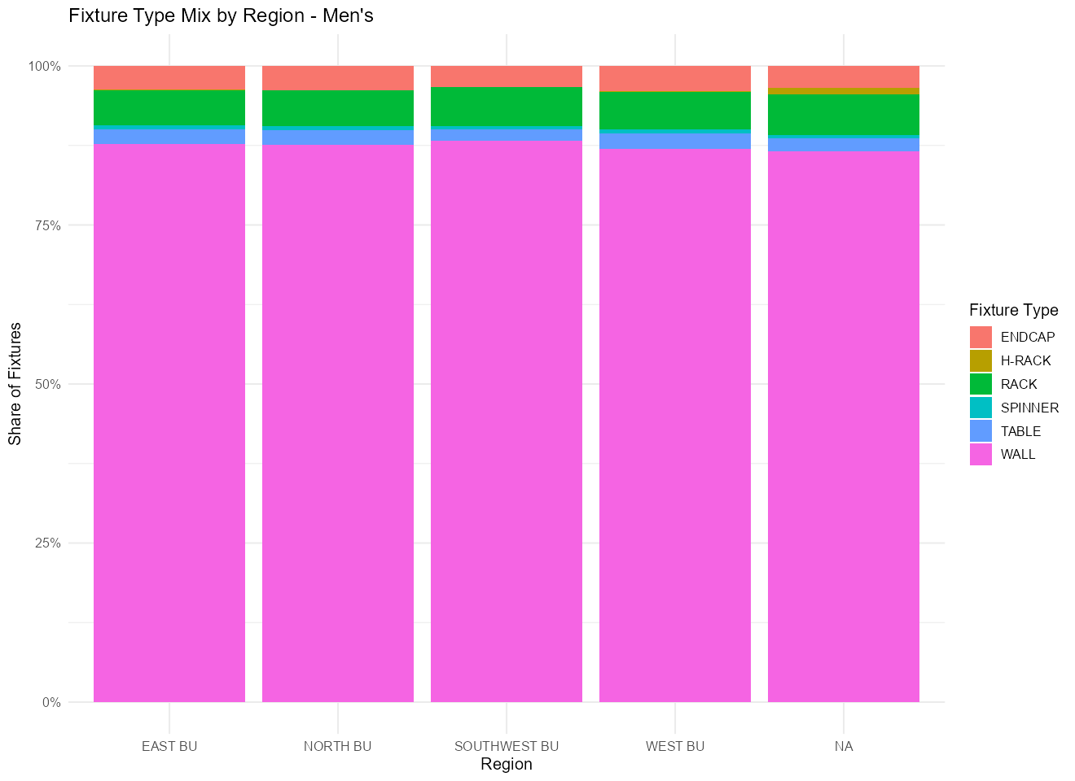
Men’s Departments: Stable and Uniform Space Allocation
Takeaway:
Fixture space is distributed across many subcategories
Allocation per subcategory is relatively small
Fixture usage is concentrated in wall-based fixtures
Notes:
Cody

Slide 36
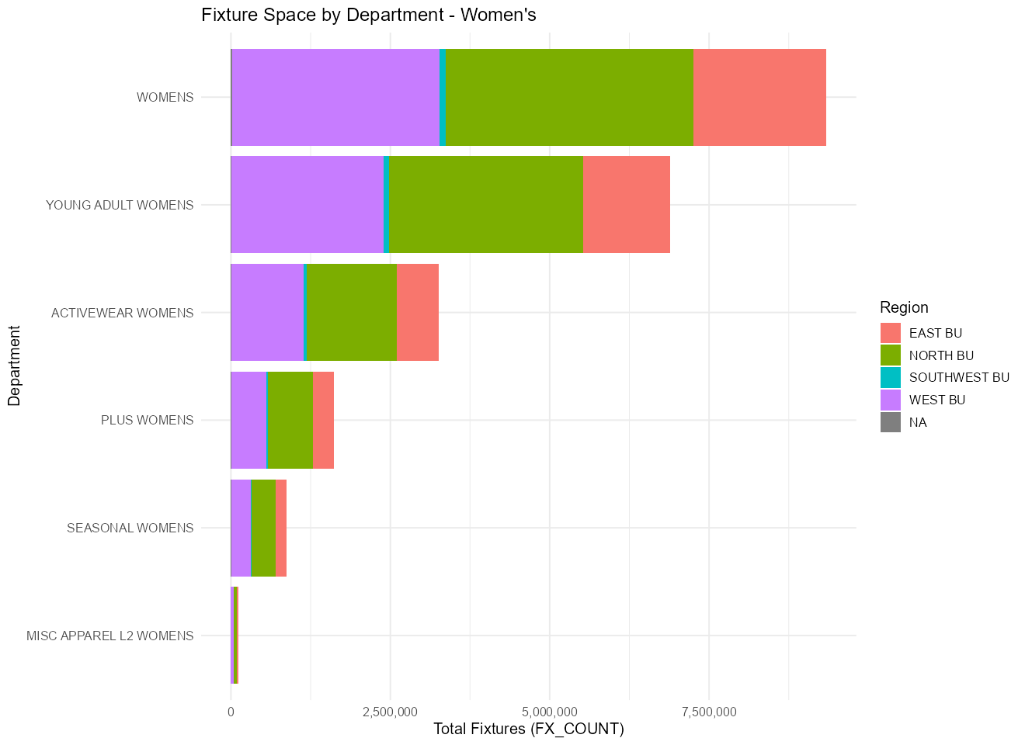
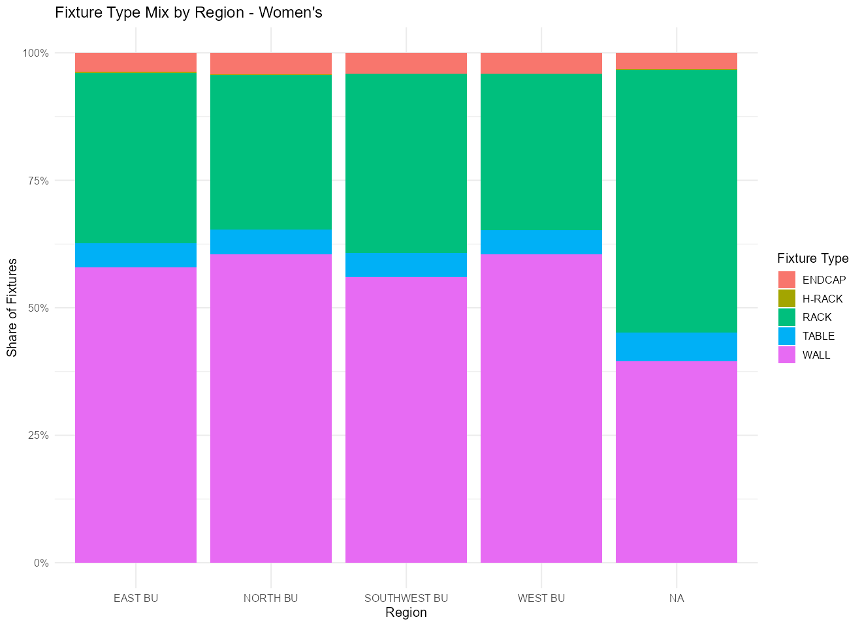
Women’s Departments: Flexible and Concentrated Space Allocation
Takeaway:
Fewer subcategories account for most fixture space
Larger allocations are given to key categories
Fixture usage is more diverse and adaptable
Notes:
Cody

Slide 37
The Data Science Process
Iteratively Improve
Understand
The Data
Model
Understand
Communicate
Stakeholder Interviews
Perform Research
Domain
Previous Approaches
Acquire/Collect Data
Prepare Data
Clean, Wrangle
Exploratory Data Analysis
Design & Validate
﻿﻿Descriptive
﻿﻿Predictive
﻿﻿Prescriptive
Deploy & Maintain
Apply Critical Thinking
Draw Conclusions
Interpret & Implicate
Visualize
Communicate
Transfer Knowledge
Current Stage
Notes:
To do:
- add the iteratively improve thing

Slide 38
Agenda
The Big Question 01
Why it Matters 02
Project Timeline 03
The Data Science Process 04
Data & Approach 05
Key Findings 06
The Model 07
Recommendations & Next Steps 08
Conclusion 09

Slide 39
Project Timeline
September 12th:
Literature Review Started
Began gathering literature over related retail optimization models & related topics
October 10th:
R & RStudio Access
All team members gained access to R and RStudio
October 27th:
Redefined Project Scope
Narrowed scope of data
Adjusted data delivery method
Moved to biweekly meetings
September 5^{th:}
Kickoff Meeting with Industry Partners
Met industry partners at Walmart Home Office
Learned background and motivation for the projects
Discussed scope and details of project
September 29th:
Laptops & Data Sample Received
Set up laptops at Walmart Home Office
Discussed file organization and data access
Received data sample
October 15th:
Began Data Sample Cleaning & EDA
Data cleaning
Data dictionary
Product Hierarchy
Modular Timeline
Notes:
Notes:
- Gap between R access and EDA is due to fall break

Slide 40
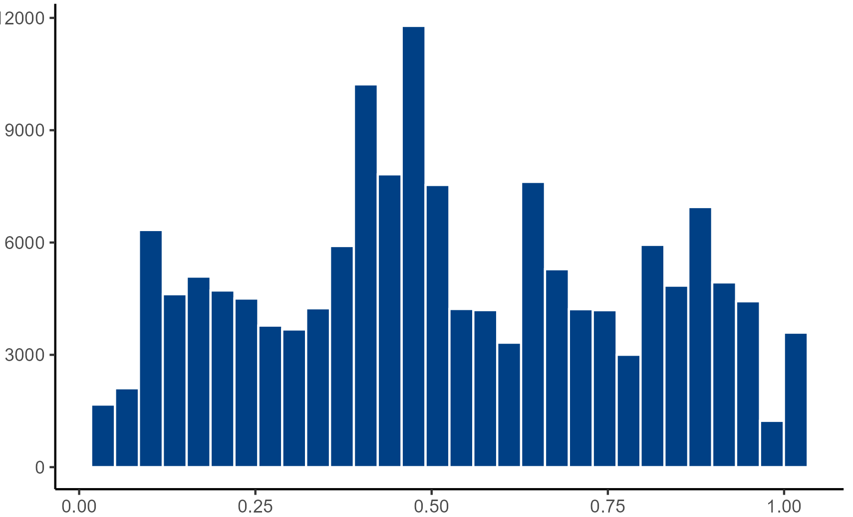
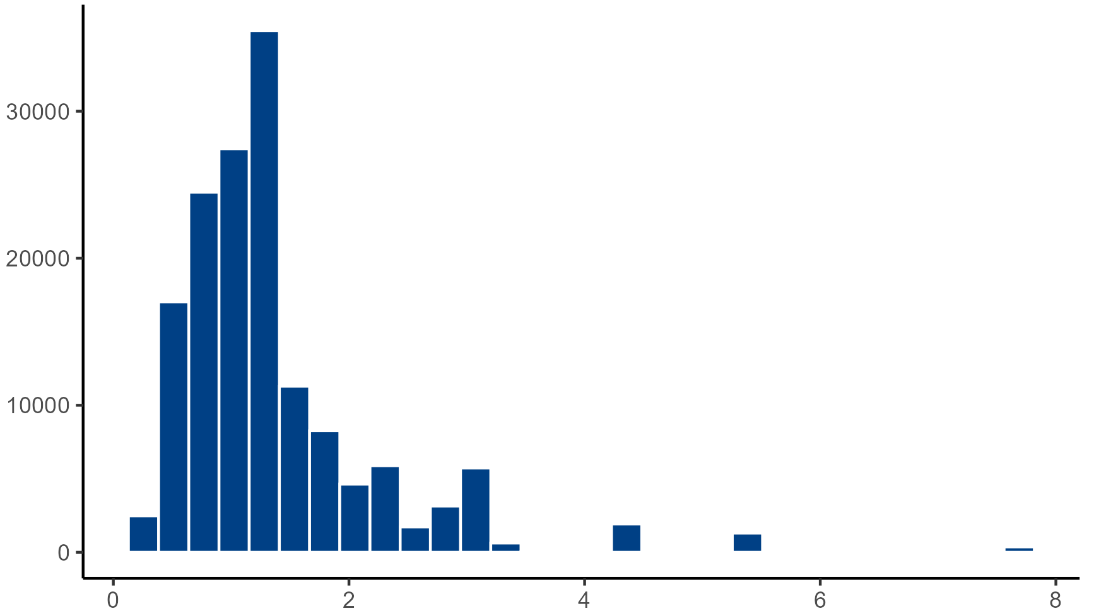
Subcategory Classification – Key Metrics
Volatility
Coefficient of Variation
Std / Mean
Presence
Proportion of weeks active
Weeks Active / Total Weeks

Slide 41
Fixture Allocation Metrics
Department | Subcategory | Store Nbr | Volatility Ratio | Bucket | Percent Weeks Active | Mean FX Count | SD FX Count
Men's | ROBES SLEEPWARE | 2336 | 0.50 | Stable | 0.84 | 0.86 | 0.43
 | PANTS US POLO | 197 | 1.64 | Seasonal | 0.28 | 0.07 | 0.12
Women's | DRESSES & ROMPERS | 200 | 0.70 | Stable | 0.90 | 5.66 | 3.97
 | FLEECE BOTTOMS | 2711 | 1.67 | Seasonal | 0.41 | 0.09 | 0.15
Department | Store Nbr | Avg. Weekly Share - Stable | Avg. Weekly Share - Moderate | Avg. Weekly Share - Seasonal | Avg. Weekly FX Count - Stable | Avg. Weekly FX Count - Moderate | Avg. Weekly FX Count - Seasonal
Men's | 189 | 0.83 | 0.14 | 0.03 | 74.3 | 12.2 | 3.1
 | 647 | 0.68 | 0.21 | 0.11 | 30.7 | 9.9 | 6.3
Women's | 189 | 0.60 | 0.31 | 0.09 | 48.2 | 25.4 | 7.5
 | 647 | 0.50 | 0.36 | 0.14 | 23.6 | 17.2 | 6.5

Slide 42
Secondary Questions:
How should off-season space be utilized when seasonal demand is low?
When should incremental fixtures be allocated to year-round categories vs seasonal ones?
What are minimum and maximum fixture counts for seasonal categories by store and department?
Notes:
Stella
How should off-season space be utilized when seasonal demand is low?
Refers to space left over when seasonal has been sold but they don’t have another seasonal catg to put there immediately
Currently mainly used for clearance
When should incremental fixtures be allocated to year-round catgs vs seasonal ones?
Increment up to the next fixture count but take space away from something else
What are min and max fixture counts for seasonal catgs by store and department?

Slide 43
Datasets
Men’s and Women’s Data
Date Dimensions
Store Dimensions
Weather Data
Content:
Weekly sales
Space metrics such as fixture data
Content:
Date data related to Walmart Weeks
Content:
Store attributes
Content:
Weather data per store per day
Useful for:
Sales trends
Space allocation insights
Main source of metrics for our model
Useful for:
Date operations
Mapping calendar weeks to Walmart Weeks
Useful for:
Potential clustering
Location mapping
Useful for:
Potential clustering
Context for sales trends
Notes:
Cody

Slide 44
Impact of the Approach
Aligns space with demand for better utilization
Improves flexibility for seasonal demand shifts
Highlights high-value subcategories
Delivers scalable, data-driven space allocation recommendations

Slide 45
Model-Driven Recommendations
Prioritize space for high-demand subcategories
Increase flexible fixture capacity where feasible
Maintain stable space for core categories
Tailor allocation strategies by department

Slide 46
Next Steps & Model Improvements
Further validate and refine demand scoring
Expand model to include store clustering(region/weather)
Improve fixture-type constraints for more realistic allocation
Validate recommendations with pilot store testing

Slide 47
Key Insights Summary Based on model results
Space allocation is concentrated in a small number of high-impact subcategories
Flexible fixtures show higher utilization across departments
Women’s departments show stronger performance with flexible space
Men’s departments maintain a higher share of stable space
Space allocation strategies should be demand-driven and department-specific

Slide 48
Key Insights Summary Based on model results
Fixture allocation is highly concentrated in a small number of subcategories
Effective allocation strategies vary by department
Flexible space improves utilization, while stable space ensures consistency

Slide 49
Takeaways
Space allocation should be driven by demand, not static rules
Different departments require different allocation strategies
Flexible fixtures provide higher efficiency and adaptability
Data-driven optimization enables better space decisions

